Slide 1
Introducción a Windows 10 Universal Windows Platform Guía para los desarrolladores de Windows 10
Javier Escobar Espinoza

Slide 2

El viaje de la convergencia
Xbox 360
Xbox One
Unified core and app platform
Converged
OS kernel
Windows 8.1
Windows 8
Converged
app model
Windows 10
Windows Phone 8.1
Windows Phone 8
Easy for users to get & stay current
Windows Phone 7.5
Windows on Devices
Notes:
Microsoft has been working to converge its client operating system and developer platforms for a long time.
In Windows Phone 7, the operating system was based on Windows CE, a great operating system for small, handheld devices, but different from the OS on ‘big’ Windows. When Windows Phone 8 was launched, we swapped out Windows CE and base it on the Windows NT kernel instead, same as our PCs. We did a similar thing with Xbox One.
But it wasn’t until Windows 8.1/Windows Phone 8.1 that we really delivered on a converged developer platform. You can build universal 8.1 apps that share a very high percentage of code and where you program against the same APIs.
With Windows 10, we’ve taken that even further and for the first time allow developers to create a single app that can run across all devices running Windows 10. Windows 10 brings developers a unified core OS across all devices and a single app platform.

Slide 3

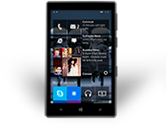
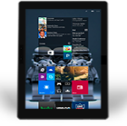
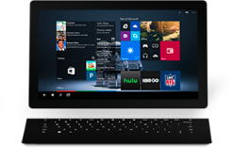
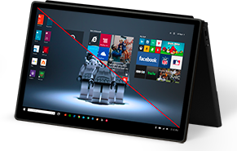
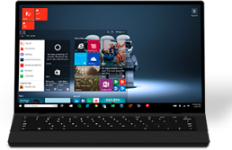
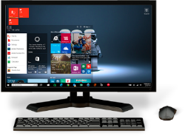
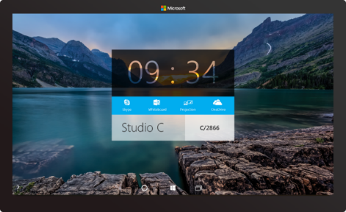

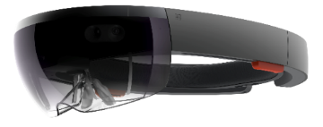



2-in-1s (Tablet or Laptop)
Classic Laptop
Desktops & All-in-Ones
Phone
Phablet
Small Tablet
Large Tablet
Windows 10
Surface Hub
Xbox
Holographic
IoT
Notes:
Windows 10 runs on a wide variety of devices, from phones with a 4.5” screen, through phablets, tablets, PCs, laptops, convertibles such as the Surface, on desktops and All-in-ones, to the Xbox in your living room and right up to giant 84” screens such as our team collaboration device, the Surface Hub. And it also takes in very tiny cheap computers such as the Raspberry Pi 2, and innovative hardware such as the Hololens.

Slide 4

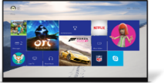
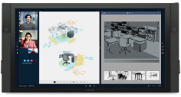

















PC
XBox
Mobile
Surface Hub
Devices +IoT
HoloLens
Universal Apps
Multiple device families
Adaptive User Interface
Reuse Existing Code
Natural User Inputs
One Store + One Dev Center
One SDK + Tooling
One Universal Windows Platform
Notes:
We’ve divided this broad range of hardware into different device families – as developers you will likely build apps that target one or more device families.
<click>
We have small devices and IoT, phones and small tablets are in the Mobile device family, large tablets and PCs in the PC (or as we more usually call it, Desktop) family, the Xbox, Surface Hub (or ‘Team’) and finally the Hololens
<click>
And all of these device families run the same developer platform – the Universal Windows Platform. You can build a single app that can run across all these device families using a single SDK and distribute apps through a single store.
Of course, with this diversity of devices, what we are *not* saying is that you should create one app that kind of works adequately across all these devices. No, we want you to create apps that shine on each device family, so we’ve added APIs, controls and tools to help you build an adaptive UI.

Slide 5
WPF
WF
MFC
XAML
HTML
Bridging technologies
Obj.C
iOS
Java
Android
Web
hosted
Win32
desktop
DirectX
.Net
languages
C++
.Net
languages
C++
& CX
WWA
.Net
runtime
Universal Windows Platform
Windows 10
operating system
Notes:
So let’s take a look at the different ways you can build apps for Windows 10.
<click>
First of all there are the ‘traditional’ ways of building apps for Windows desktop, using tools such as WPF, MFC and full .NET. These are what we term ‘CWA’ (Classic Windows Apps) and are still a great way of building apps for Windows desktop. Although, note that we are working on some tools, called Project ‘Centennial’ that will allow CWAs to be packaged for distribution through the Windows Store – more on that later.
<click>
Then, we’ve got the new UWP, which is based on the Windows Runtime APIs that we used for building Windows Store apps in Windows 8.x and Windows Phone 8.1. Here you can use HTML and JavaScript to create universal Windows apps, or XAML and C#/VB or C++, or you can use DirectX and one of the many popular middleware packages to create games. And these all build upon the UWP APIs and can run across all Windows 10 devices.
<click>
Finally, we’ve got a number of bridging technologies. We want to enable developers to use whichever technologies they are comfortable with, and help them to create Windows apps. So we’ve got eh Windows Bridge for iOS, the Windows Bridge for Android, hosted Web Apps to help web sites to be discoverable through the Windows Store and to call UWP APIs, and a Bridge for classical Windows Apps. More on all of those soon.

Slide 6
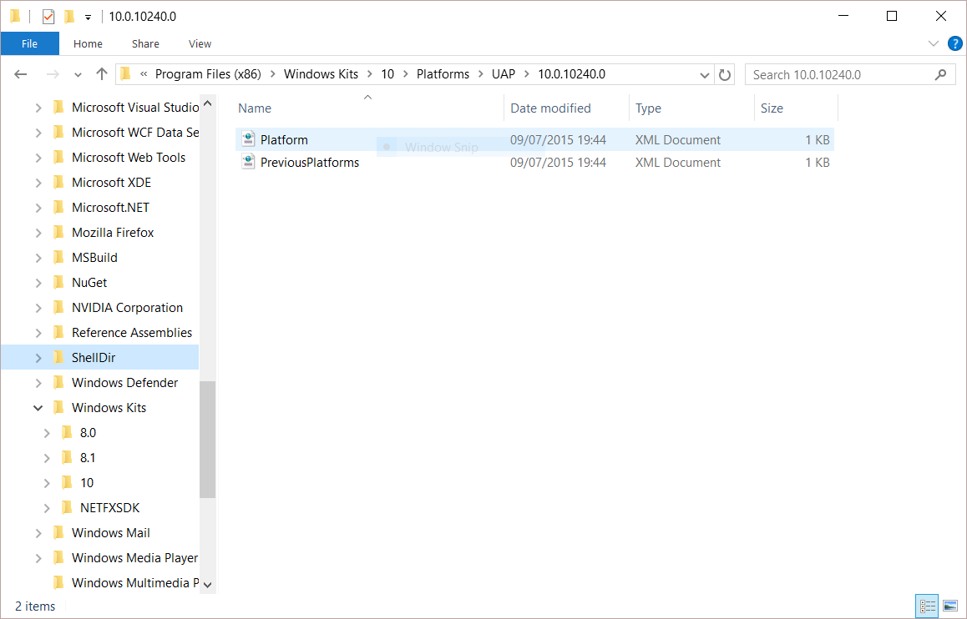
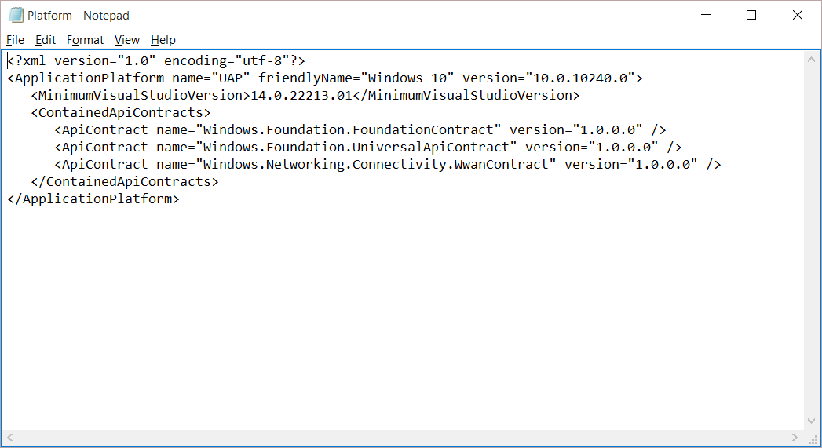
Universal Windows Platform
Un solo grupo API
APIs de garantía
¡Los mismo en todos los dispositivos!
Universal Windows Platform
Windows Core
Desktop
Device
Phone
Device
Xbox
Device
Notes:
So, what is the Universal Windows Platform?
It’s a single API surface that is consistent across all Windows 10 devices.
This guaranteed API surface is what enables developers to build a single app that can run across all devices.
What we’ve done is taken the Windows Runtime APIs that we first launched with Windows 8, massively expanded it and we’ve also componentized it, dividing it into a number of ‘contracts’.
Why ‘contract’? – Because these components provide a contract between the platform and you, the developer, that a certain major version of a contract will offer a guaranteed API surface and behaviors, even through many minor revisions. It allows us to innovate and enhance the platform by releasing updated components exposing new capabilities and allows you to develop apps against a versioned API.

Slide 7
Muchísimas APIs…
Storage
DirectX 12
Speech and Cortana
Networking
NFC and Bluetooth
Holographic
Audio and Video
Appointments/Calendar
Authentication Broker
Background Transfer
Maps and Location
Sensors: Accelerometer, light, magnet …
Tiles and Notifications
App to App and App Services
Inking
XAML
Background Tasks
Data Roaming
Data.XML
Media Casting
Muchas, muchas más…
Notes:
And it’s a big API!
Here’s just a sample of some of the feature areas that UWP APIs cover.
As you build apps against the UWP, you will find that the vast majority of the things you want to enable can be achieved by APIs that are in the UWP – and therefore available across all Windows 10 devices. We do have a way of calling device family-specific APIs, and we’ll come onto that shortly. But most of what you need can be found in the UWP.

Slide 8
Apps don't target Windows 10, apps target the UWP
Notes:
And this is a subtle change in your thinking as an app developer: you’re not building apps against an OS – Windows 10 – you’re building apps against the Universal Windows Platform, which is serviced and is updated independently of the OS.

Slide 9
Requirements for UWP Development

Slide 10
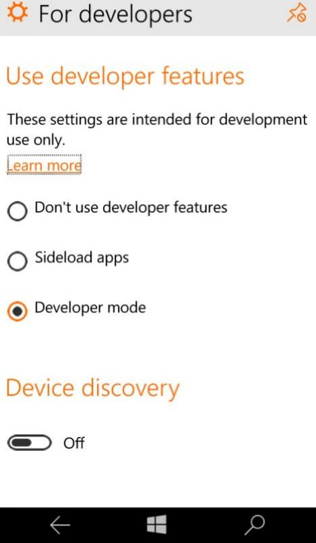
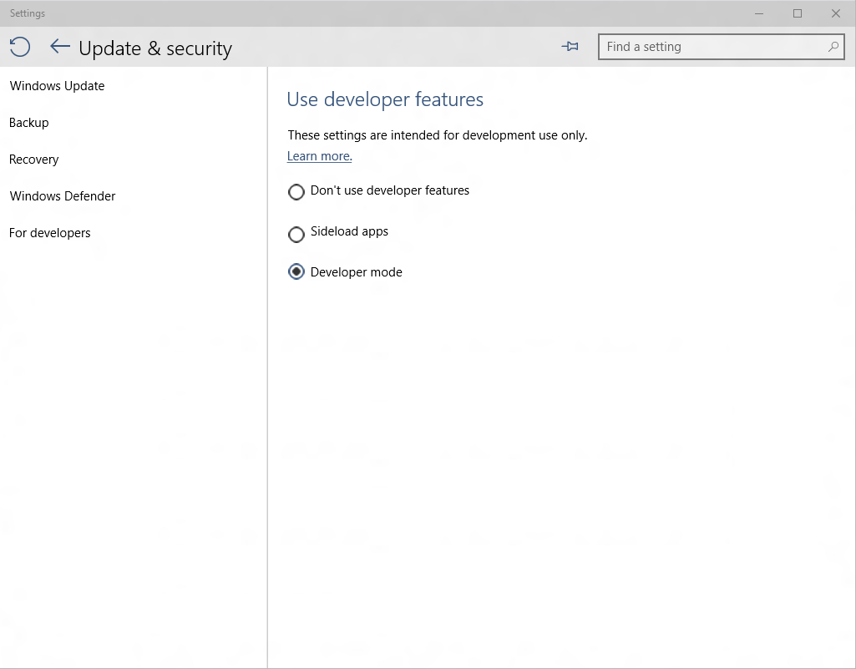
Developer unlock
Notes:
There is a different approach for development for Windows 10 devices. A developer license is no longer required for each device that you want to use to develop, install or test your app. You just enable a device once for these tasks from the settings for the device. That's it. No more renewing your developer licenses every 30 or 90 days!
You can easily developer unlock any Windows 10 PC/laptop/tablet or Phone just by going to System Settings to allow you to deploy apps to the device directly from Visual Studio and carry out on-device debugging and testing, or just for sideloading apps that have not been certified by the Windows Store.

Slide 11
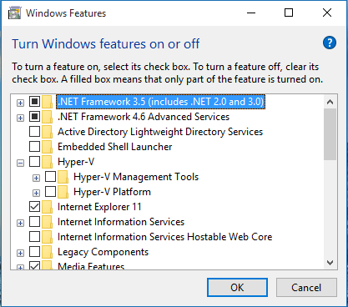
Activate Hyper-V

Slide 12
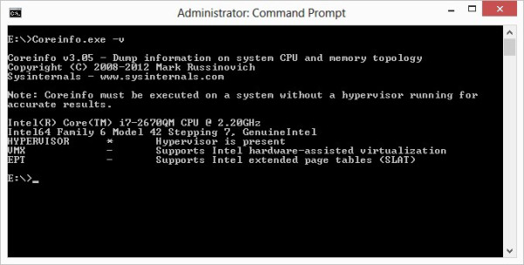
SLAT support

Slide 13
Demo: Getting started
Notes:
See demo notes on github

Slide 14
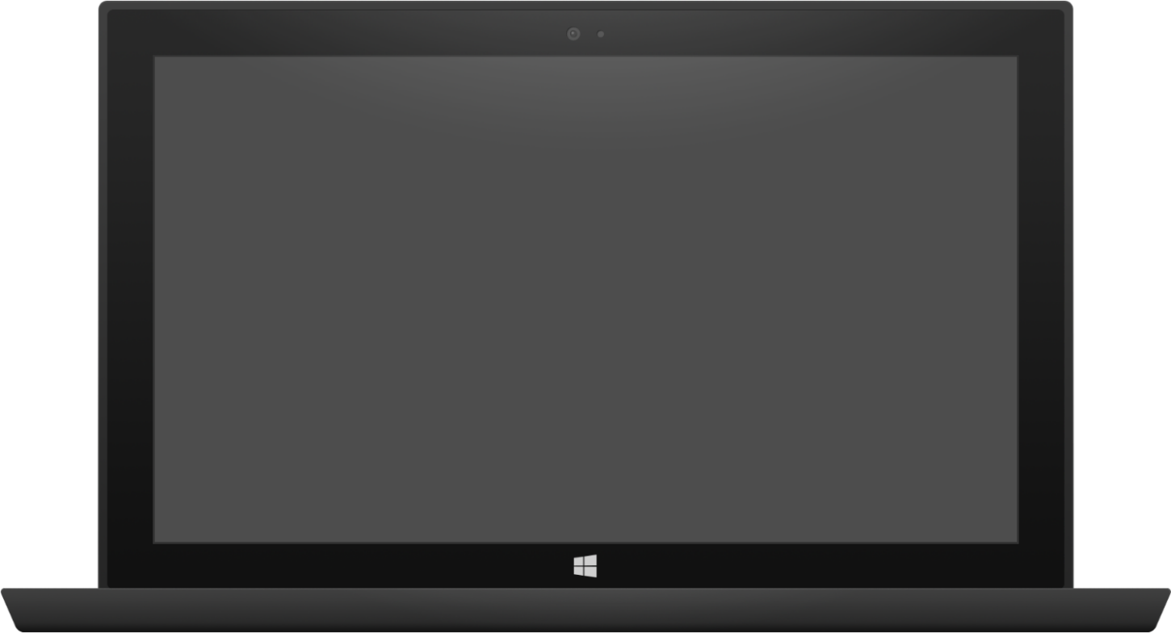

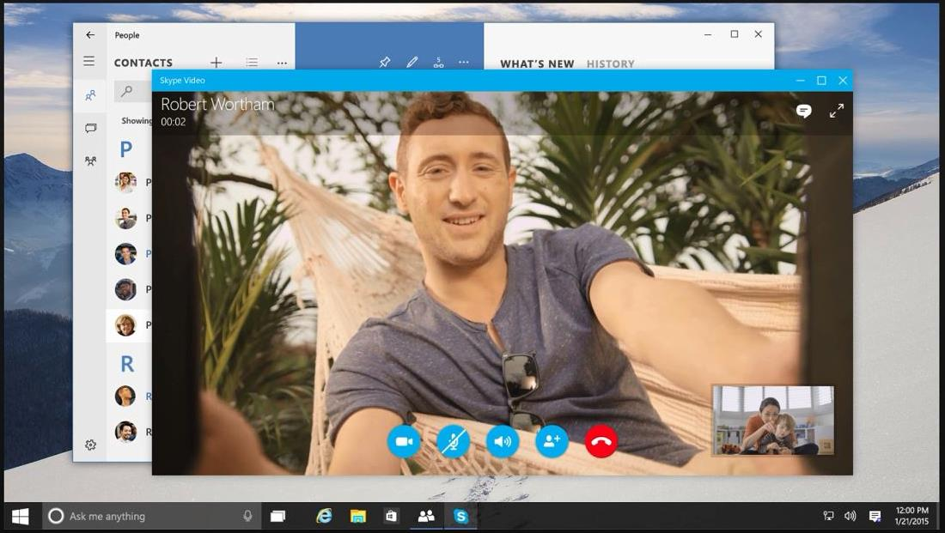

Adaptive design
Tablet (landscape) / Desktop
Phone (portrait)
Notes:
Here is an example of responsive design:
On the large screen on the right, we take full advantage of the size of the window the app is running in, we lay out the control buttons in a line, and we place the thumbnail of the people making the call off to the right.
On the small phone screen, it’s essentially the same, but the image is cropped, and the large red End Call button has been placed underneath the other buttons, while the thumbnail moves up the page to just above the call control buttons.

Slide 15
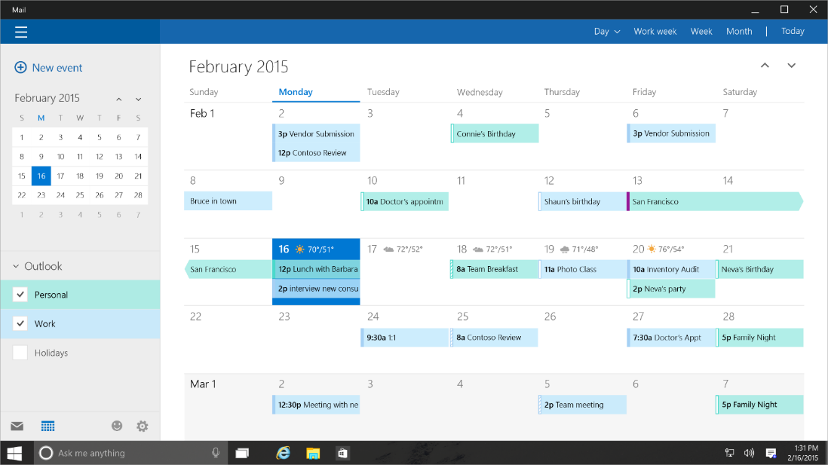
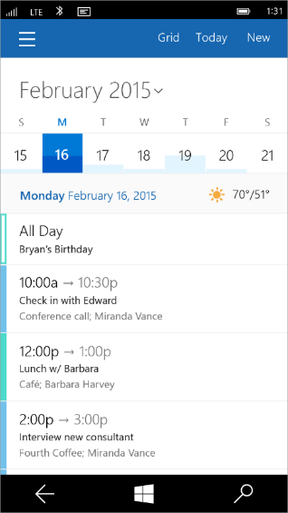
Tailored design
Tablet (landscape) / Desktop
Phone (portrait)
Notes:
Adaptive controls are great, and responsive layout will get you a long way, but we know there will be cases where the app designer wants to do something more custom or more tailored than the adaptive controls will allow.
This desire might be motivated by hardware differences. For example, an app that will run on an Xbox might want to create some customizations for navigation using a game controller.
Or it might be motivated by screen size and usability. A designer might want to position a menu at the bottom of a phone screen to make it more usable with a single hand.
For these cases, we enable developers to create what we call a tailored user experience. In this case, the code is the same, but the developer creates custom XAML to deliver the desired design on the right device or in the right set of conditions.
Tailored design goes beyond Adaptive UX
Developers can create custom experiences for certain devices
The code is the same, but custom XAML can deliver the experience a developer wants

Slide 16
Users love apps that give a great experience on all their devices
Notes:
Many users of mobile devices these days carry around two or more different computing devices. And they will want to use their favorite apps on their phone, their tablet, their convertible and their desktop machines.
The apps that will get the best ratings will be those that give a great user experience on all the users’ devices!

Slide 17
Bridging Technologies
Notes:
The Universal Windows Platform (UWP) is a single app platform that is available across all Windows device families, enabling you to reach a new user base and open up new revenue opportunities. From PCs to tablets, phones, Surface Hub, and Raspberry Pi and soon to include Xbox, and HoloLens – you can reach all these devices and look great on them all using one store and one codebase.
Following the launch of Windows 10, we are also releasing four Windows Bridge toolkits that enable you to quickly bring your existing code base to the Universal Windows Platform and add capabilities such as live tiles, active notifications, and Windows Store in-app purchases. Each toolkit provides you with tools and run-time technologies that are tailored for your codebase.

Slide 18
Web Apps
pp
NEW: Hosted Web Apps
Bring your website experience to the Windows Store
Leverage your web investments and developer workflow
Full access to Universal APIs, including
Tiles, Notifications, Camera, Contact List, Calendar
.appx
HTML
CSS
JS
Universal Windows Platform
Notes:
First up is Hosted Web Apps.
Beyond making the web run great in the browser itself, Windows 10 provides a powerful new path for sites to become apps.
<click>
With Windows 10, you can re-use your existing web site code and create an app that points directly to your URL.
You don’t need to re-write your server code into packaged client code!
<click>
You can access Universal Windows Platform APIs directly from the web code that came down from your server.
<click>
And you can distribute the app you’ve made in the Windows Store.
This new path is fully integrated into your existing web workflow.
You can continue to use the same tools, libraries, and services you use today.
You can continue to deploy to your servers to make updates.

Slide 19
Windows Bridge for Android
Windows Bridge for iOS
Project Centennial

Slide 20
Development tools

Slide 21

Where can I develop?
Windows 10
Requires Visual Studio 2015
Windows 8.1 & Windows Server 2012 R2
The Visual Studio designer does not function
Debugging requires a Windows 10 device or Remote Debugging Tools
Notes:
Where can you do development?
Visual Studio 2015 and the Tools for Windows 10 can run on PCs running Windows 10, on PCs running Windows 8.1 and on Windows Server 2012 R2.
To get the best developer experience including full availability of tooling features such as the visual designer, you should use a machine running Windows 10.

Slide 22
Visual Studio 2015 Editions
Enterprise
Architecture Modelling, Diagnostics, VSO/ALM & Release Management
Professional
Architecture Validation, VSO/ALM & Feedback Management
Community Editions
Visual Studio Professional Edition
Notes:
Visual Studio 2015 comes in a number of editions that serve the needs of different groups of developers.
Visual Studio Enterprise with MSDN is an Enterprise grade solution with advanced capabilities for teams working on projects of any size or complexity, including advanced testing and DevOps.
Visual Studio Professional with MSDN offers professional developer tools and services for individual developers or small teams.
Visual Studio Community is a free, full-featured and extensible tool for developers building non-enterprise applications.

Slide 23
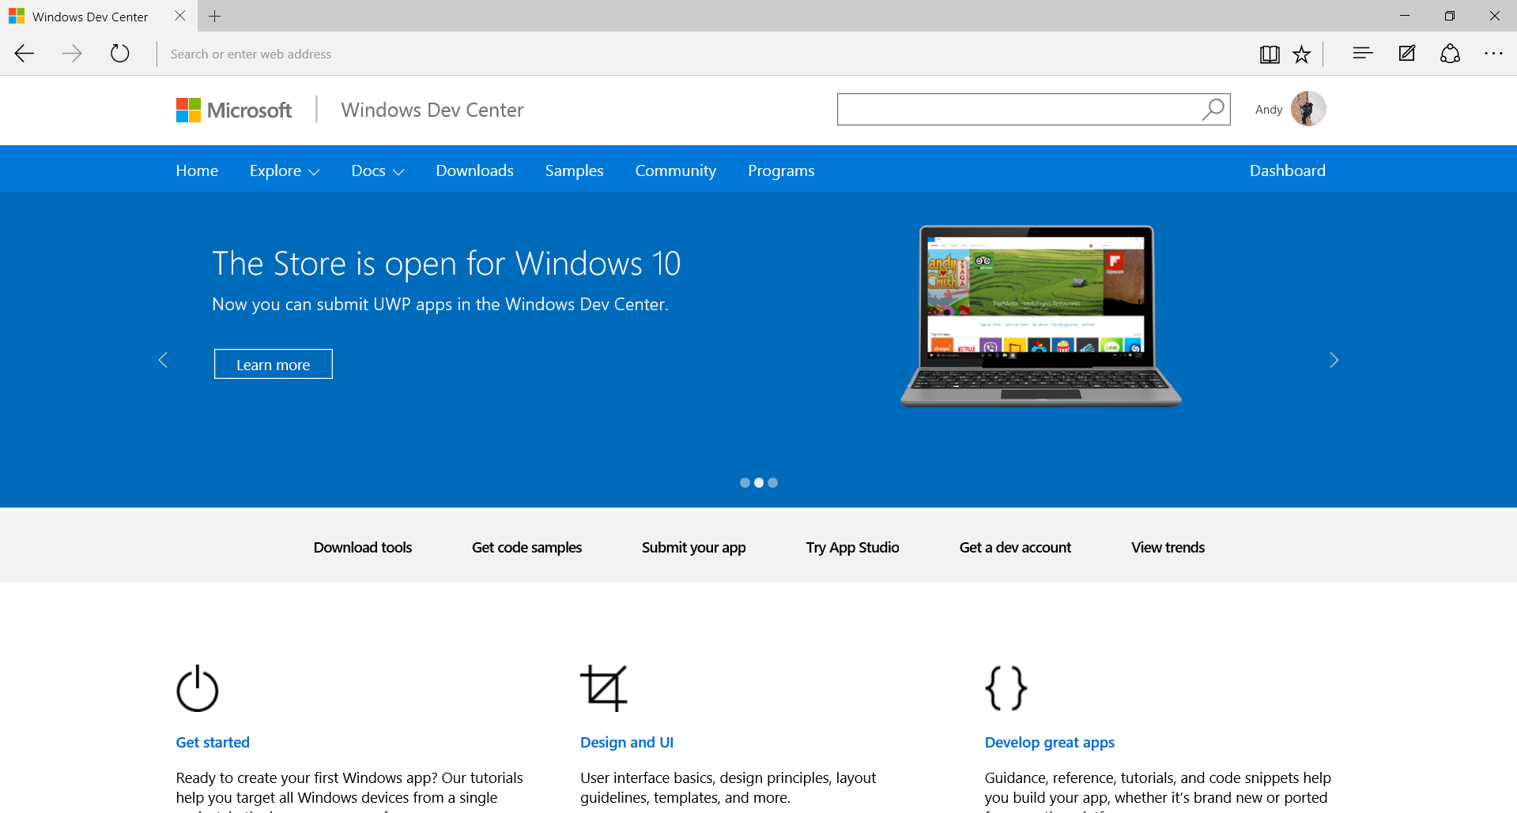
dev.windows.com
Notes:
Finally, for any questions on how to build apps for Windows 10, and for access to the Dev Center, or to take part in the forums, go to our home on the web: dev.windows.com.
Here you will find tutorials, samples, getting started guides and access to the full documentation.
Everything you need to help you create great UWP apps for Windows 10!
https://msdn.microsoft.com/library/windows/apps/dn894631.aspx?f=255&MSPPError=-2147217396

